Slide 1
SPOTBOX
Project Owner : Burakhan SEVİM
Mentor : Dr. Cihat ÇETİNKAYA
Muğla Sıtkı Koçman Üniversitesi

Slide 2
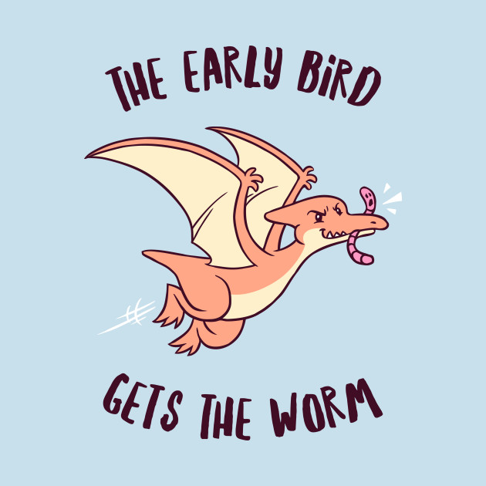

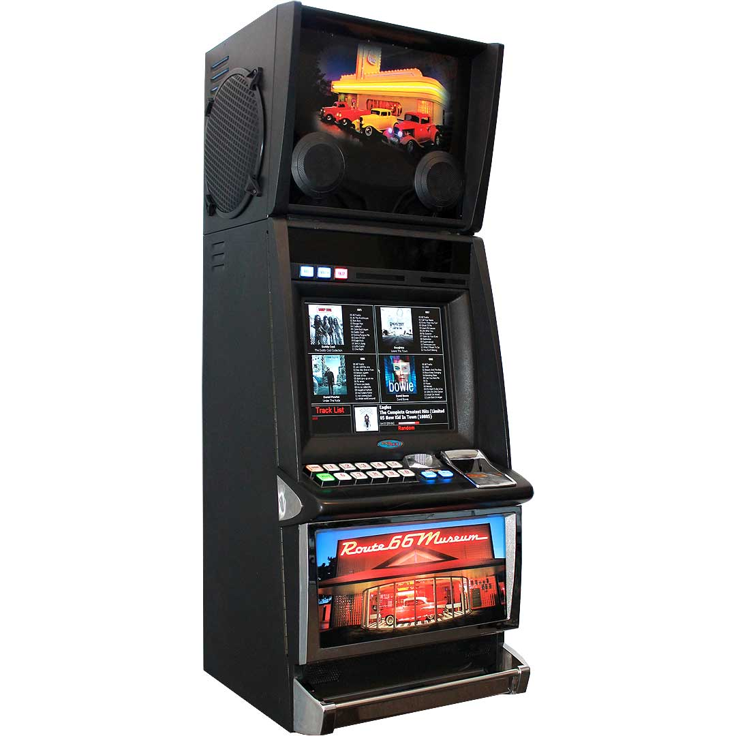
Motivation
Early bird gets the worm.
JUKEBOX

Slide 3
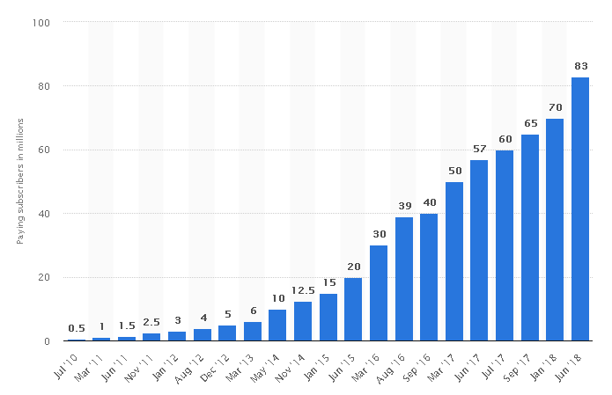
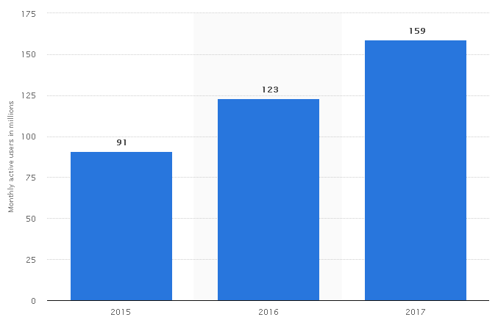
Worldwide Spotify Usage
Paid
Free

Slide 4
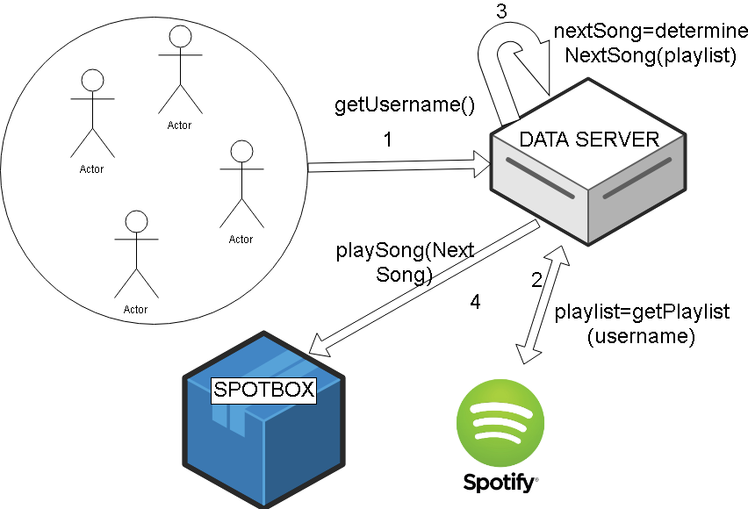

Slide 5


TECHNOLOGIES

